Slide 1
Wireless Lighting System

Slide 2
Components involved
Arduino UNO R3 Board
Relay
AC Bulb
IR Receiver sensor
Jumpers and connecting wires
AC power source (Socket)
Breadboard (for prototyping)

Slide 3
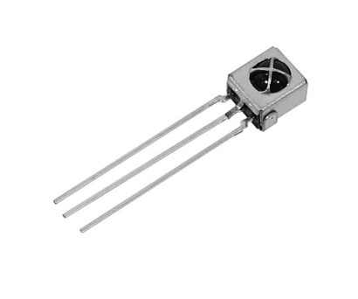
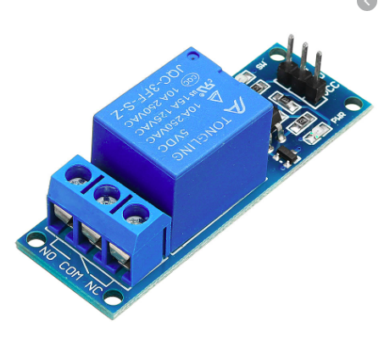
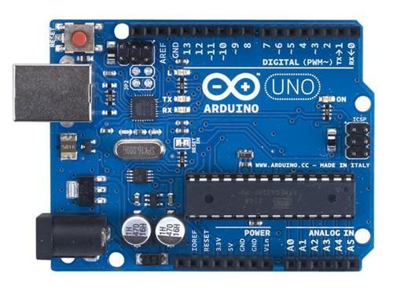
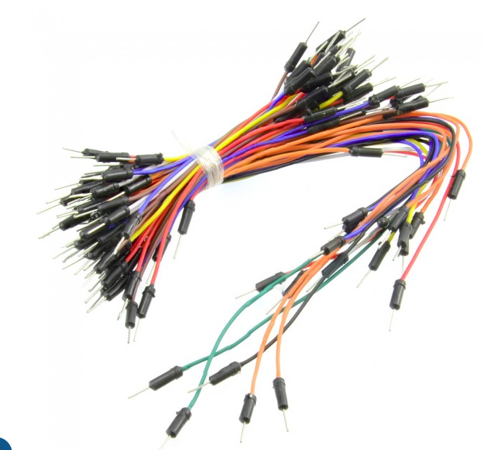
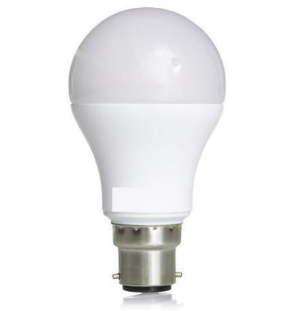
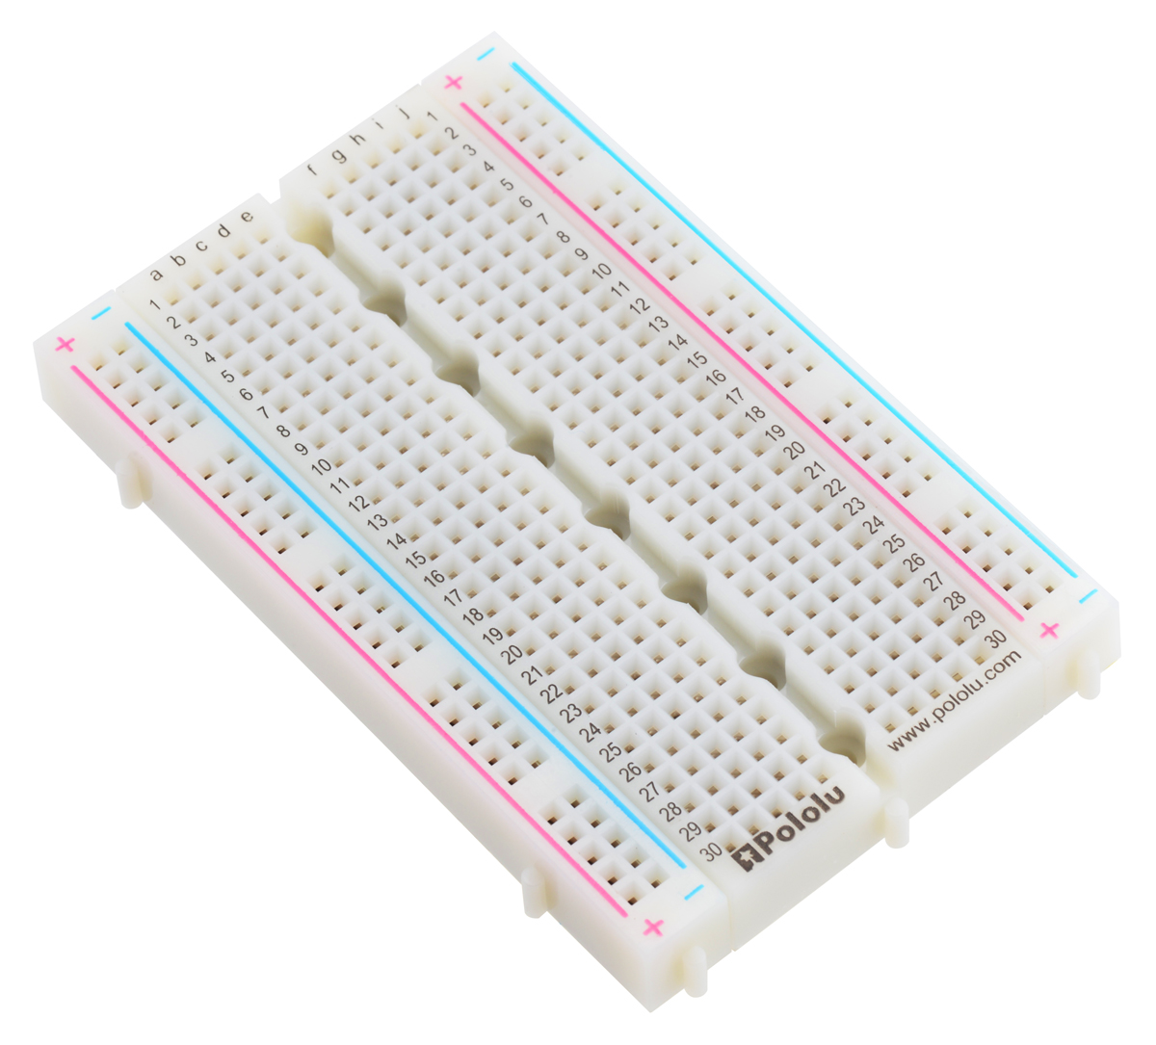
IR Receiver sensor
Relay Module (1 ch)
Arduino UNO R3 board
Jumpers
AC Bulb
Breadboard

Slide 4
Working Principle of a Relay
It works on the principle of an electromagnetic attraction.
When the circuit of the relay senses the fault current, it energizes the electromagnetic field which produces the temporary magnetic field.
This magnetic field moves the relay armature for opening of closing the connection.

Slide 5
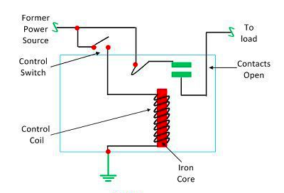

Slide 6
Working Principle of IR Receiver Sensor
IR Receiver is also called a photodiode.
The emitter is an IR LED and the detector is an IR photodiode.
The IR photodiode is sensitive to the IR light emitted by an IR LED. The photodiode's resistance and output voltage change in proportion to the IR light received.

Slide 7
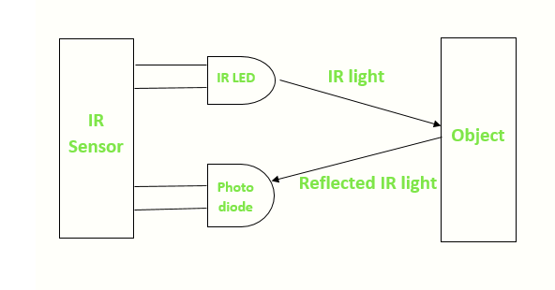

Slide 8


